Slide 1

Data 603 – Big Data Platforms
Lecture 5
Structured APIs (Part 1)

Slide 2
Lecture Outline
Reading
Docker Intro
Going beyond RDD
Apache Spark Structured API
Apache Spark DataFrames
Working with columns
Working with rows
Dataset API
Spark SQL Intro
Homework

Slide 3
Reading
Learning Spark 2nd ed.
RDD Review: Chapter 3 (1st half)
Today’s Material: Chapter 3 (2nd half) and 4
Next week: Chapter 5
https://pages.databricks.com/rs/094-YMS-629/images/LearningSpark2.0.pdf

Slide 4
Going beyond RDD

Slide 5
Spark Core Abstractions
Low-level RDD
Structured API
Datasets
DataFrames
SQL Tables
RDDs
Spark SQL Engine

Slide 6
RDD Characteristics Review
Dependencies
Instructions on how to construct an RDD with required inputs
RDDs can be recreated with dependencies and application of operations on them (Resiliency)
Partitions (with locality information)
Collection of rows
Ability to split the work to parallelize computation on partitions across executors
One partition = parallelism of one
Compute function: Partition => Iterator[T]
Associated with each RDD is a compute function that produces an Iterator[T] for the data that will be stored in RDD

Slide 7
Issues with RDDs
The compute function (join, filter, select, aggregation) is opaque to Spark – Spark only sees it as a lambda expression
Iterator[T] data type is opaque to Python RDDs – generic object in Python
Spark is not able to optimize the expression
Spark has no knowledge of the specific data type in T
Telling Spark how to do things (vs. what you want) can make the code more complicated to write and read.

Slide 8
Issues with RDDs
Example from the textbook:
“Aggregating all the ages for each name, group by name, and then average the ages”
dataRDD = sc.parallelize(
[("Brooke", 20), ("Denny", 31), ("Jules", 30),
("TD", 35), ("Brooke", 25)])
# Use map and reduceByKey transformations with their lambda
# expressions to aggregate and then compute average
agesRDD = (dataRDD
.map(lambda x: (x[0], (x[1], 1)))
.reduceByKey(lambda x, y: (x[0] + y[0], x[1] + y[1]))
.map(lambda x: (x[0], x[1][0]/x[1][1])))

Slide 9
Apache Spark Structured API

Slide 10
Structuring Spark
Add clarity and simplicity by using common patterns found in data analysis to express computations
High-level operations: filtering, selecting, counting, aggregating, averaging and grouping
Common set of operators in DSL available as APIs
Tell Spark what you wish to compute with the data NOT how to do it
Provides an opportunity for Spark optimize the query plan for execution
Spark’s high-level APIs are uniform across its components and languages
Similar APIs for Python and Scala => Built on Spark SQL engine
DSL operators that are modeled after relational operators that are similar to SQL

Slide 11
Structuring Spark - Benefits
Better performance and space efficiency via DataFrame and Dataset APIs
Spark is able to parse queries and understand the intention, it can optimize and arrange operations for efficient execution.
Spark has better understanding of what needs to be done:
e.g. group by names, aggregate ages and computing the average.
Expressivity, simplicity, composability and uniformity
Ability to compose entire computations using high-level operators as simple queries.
Possible due to the Spark SQL engine upon which the high-level Structured APIs are built
NOTE:
You are always transforming and operating on DataFrames as structured data
Possible to switch back to unstructured low-level RDD API

Slide 12
Apache Spark DataFrames

Slide 13
DataFrame API
Inspired by Pandas DataFrames => structure, format, operations
Analogous to distributed in-memory tables with named columns and schemas
Each column has a specific data type: integer, string, array, map, real, date, timestamp, etc.
Schema: A list that defines the columns and types within those columns
A named column in a DataFrame and its associated Spark data type can be declared in the schema
DataFrames are immutable
When columns are added or changed, a new DataFrame is created
Spark keeps lineage of all transformations

Slide 14
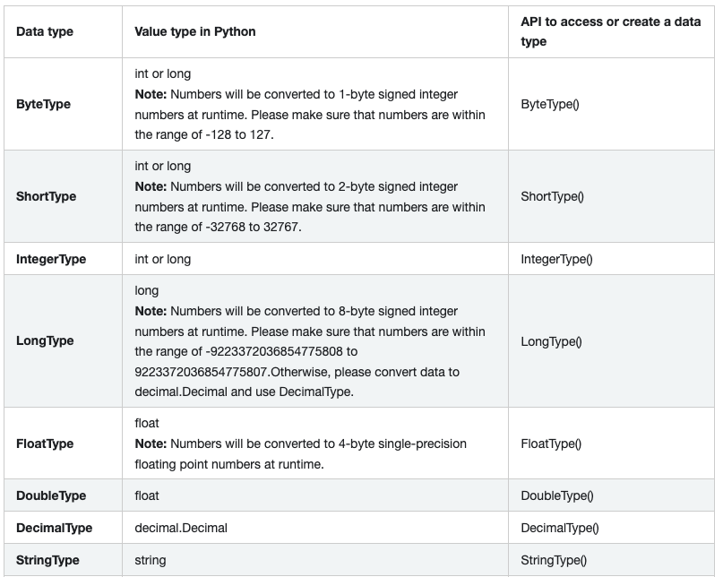
Spark Data Types 1/2
https://spark.apache.org/docs/latest/sql-ref-datatypes.html

Slide 15
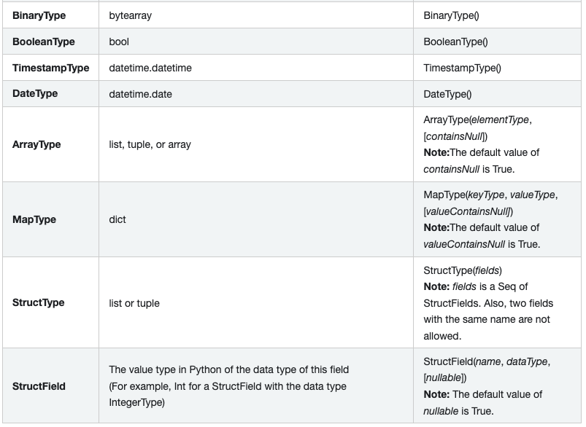
Spark Data Types 2/2
https://spark.apache.org/docs/latest/sql-ref-datatypes.html

Slide 16
Complex Types
ArrayType(elementType, containsNull)
Values comprising a sequence of elements with the type of elementType.
MapType(keyType, valueType, valueContainsNull)
Values comprising a set of key-value pairs.
The data type of keys is described by keyType and the data type of values is described by valueType.
For a MapType value, keys are not allowed to have null values.
StructType(fields)
Represents values with the structure described by a sequence of StructFields (fields).
StructField(name, dataType, nullable)
Represents a field in a StructType. The name of a field is indicated by name. The data type of a field is indicated by dataType.
https://spark.apache.org/docs/latest/sql-ref-datatypes.html

Slide 17
DataFrame Schemas
Q: What is a data schema?

Slide 18
DataFrame Schemas
Q: What makes structured data “structured”?

Slide 19
DataFrame Schemas
Schemas come into play when reading structured data from an external source
Defining schema up front vs. schema-on-read
Relieving Spark from the onus of inferring data types
Q: Why is this important for ingesting large data sets?
Spark does not need to create a separate job for the purpose of reading a large portion of the file to ascertain the schema
Provides data type validation on columns
When reading a large amount of data, schema should be defined up front.
Schema can be defined in two ways
Programmatically
Using Data Definition Language (DDL) string

Slide 20
Working with columns

Slide 21
DataFrame Columns
Named columns are conceptually similar to columns in RDBMS tables.
Named column describe a type of field.
Columns are objects with public methods represented by the Column type.
Spark documentation refers to both col() and Column
col() is a standard built-in function that returns a Column

Slide 22
DataFrame Columns
Logical or mathematical expressions can be used on columns
expr("columnName * 5") or
(expr("columnName - 5") > col(anothercolumnName))
expr() is part of the pyspark.sql.functions (Python) and org.apache.spark.sql.functions (Scala) packages.
Each Column object in a DataFrame is a part of a Row object.
All Rows form a DataFrame

Slide 23
pyspark.sql.Column Cheat Sheet
API | Description | Example
alias(*alias, **kwargs) | Returns this column aliased with a new name or names (in the case of expressions that return more than one column, such as explode). | df.select(df.age.alias(“age2”)).collect()
asc() | Returns a sort expression based on ascending order of the column. | df.select(df.name).orderBy(df.name.asc()). collect()
astype(dataType) | astype() is an alias for cast(). | See cast()
between(lowerBound, upperBound) | A boolean expression that is evaluated to true if the value of this expression is between the given columns. | df.select(df.name, df.age.between(2, 4)).show()
bitwiseAND(other) | Compute bitwise AND of this expression with another expression. | df.select(df.a.bitwiseAND(df.b)).collect()
bitwiseOR(other) | Compute bitwise OR of this expression with another expression. | df.select(df.a.bitwiseOR(df.b)).collect()
bitwiseXOR(other) | Compute bitwise XOR of this expression with another expression. | df.select(df.a.bitwiseXOR(df.b)).collect()
cast(dataType)[source] | Convert the column into type dataType. | df.select(df.age.cast("string").alias('ages')).collect()
contains(other) | Contains the other element. Returns a boolean Column based on a string match. | df.filter(df.name.contains('o')).collect()
https://spark.apache.org/docs/latest/api/python/reference/api/pyspark.sql.Column.html

Slide 24
pyspark.sql.Column Cheat Sheet
API | Description | Example
desc() | Returns a sort expression based on the descending order of the column. | df.select(df.name).orderBy(df.name.desc()). collect()
endswith(other) | Equality test that is safe for null values. | df.filter(df.name.endswith('ice')).collect()
eqNullSafe(other) | astype() is an alias for cast(). | df2.select( ... df2['value'].eqNullSafe(None), df2['value'].eqNullSafe(float('NaN')), df2['value'].eqNullSafe(42.0)).show()
isNotNull() | True if the current expression is NOT null. | df.filter(df.height.isNotNull()).collect()
isNull() | True if the current expression is null. | df.filter(df.height.isNull()).collect()
isin(*cols) | A boolean expression that is evaluated to true if the value of this expression is contained by the evaluated values of the arguments. | df[df.name.isin("Bob", "Mike")].collect()
like(other) | SQL like expression. Returns a boolean Column based on a SQL LIKE match. | ddf.filter(df.name.like('Al%')).collect()
startswith(other) | String starts with. Returns a boolean Column based on a string match. | df.filter(df.name.startswith('Al')).collect()
substr(startPos, length) | Return a Column which is a substring of the column.. | df.select(df.name.substr(1, 3).alias("col")).collect()
when(condition, value) | Evaluates a list of conditions and returns one of multiple possible result expressions. If Column.otherwise() is not invoked, None is returned for unmatched conditions. | df.select(df.name, F.when(df.age > 4, 1).when(df.age < 3, -1).otherwise(0)).show()
https://spark.apache.org/docs/latest/api/python/reference/api/pyspark.sql.Column.html

Slide 25
Working with rows

Slide 26
DataFrame Rows
Each DataFrame column is part of a row
A row is an order collection of columns
A Row in Spark is a generic object type and all rows together constitute a DataFrame
Row objects can be used to create DataFrames

Slide 27
DataFrame Rows
Row is an object in Spark and an ordered collection of fields
A Row object can be instantiated, and each of its fields can be accessed using an index (0-based).
A row in DataFrame. The fields in it can be accessed:
like attributes (row.key)
like dictionary values (row[key])
key in row will search through row keys.

Slide 28
DataFrame Rows
Row objects can be used to create DataFrames
In practice, contents of files are read in as DataFrames (along with schema information to make the reading more efficient).
rows = [Row("Matei Zaharia", "CA"), Row("Reynold Xin", "CA")]
authors_df = spark.createDataFrame(rows, ["Authors", "State"])
authors_df.show()

Slide 29
DataFrame Rows
Row can be used to create another Row-like class
Person = Row("name", "age")
>> <Row('name', 'age')>
Person("Alice", 11)
>> Row(name='Alice', age=11)
https://spark.apache.org/docs/latest/api/python/pyspark.sql.html#pyspark.sql.Row

Slide 30
DataFrame Operations
Loading of DataFrames from a data source:
DataFrameReader, an interface for reading data into a DataFrame
A large list of data sources including JSON, CSV, Parquet, Text, Avro, ORC, etc.
Writing DataFrames to files or other targets:
DataFrameWriter, an interface for writing data back to a data source
Parquet using snappy compression is the default format
The schema is included in the Parquet file itself – no need to manually specify a schema during read
Both support multiple data sources

Slide 31
DataFrame Operations
Reading
# Programmatic way to define a schema
fire_schema = StructType([StructField('CallNumber', IntegerType(), True), ...
# Use the DataFrameReader interface to read a CSV file
sf_fire_file = "/databricks-datasets/learning-spark-v2/sf-fire/sf-fire-calls.csv"
fire_df = spark.read.csv(sf_fire_file, header=True, schema=fire_schema)
Q: What is the spark object above?

Slide 32
DataFrame Operations
Writing to a file
Saving as a table
Saving a DataFrame as a table registers metadata with the Hive metadata store.
parquet_path = ...
fire_df.write.format("parquet").save(parquet_path)
parquet_table = ... # name of the table
fire_df.write.format("parquet").saveAsTable(parquet_table)

Slide 33
DataFrame Operations
Projection – returning rows matching certain conditions using filtering
select() method is used
Filters can be expressed using filter() or where() method
few_fire_df = (fire_df
.select("IncidentNumber", "AvailableDtTm", "CallType")
.where(col("CallType") != "Medical Incident"))
few_fire_df.show(5, truncate=False)

Slide 34
DataFrame Operations
Column manipulation
Renaming, adding and dropping columns using desired column names in the schema with StructField. e.g. when there are spaces in the column name.
A column can be renamed using withColumnRenamed() method.
new_fire_df = fire_df.withColumnRenamed("Delay", "ResponseDelayedinMins")
(new_fire_df
.select("ResponseDelayedinMins")
.where(col("ResponseDelayedinMins") > 5)
.show(5, False))
﻿fire_ts_df = (new_fire_df
.withColumn("IncidentDate", to_timestamp(col("CallDate"), "MM/dd/yyyy"))
.drop("CallDate"))
For date time formats refer here: https://spark.apache.org/docs/latest/sql-ref-datetime-pattern.html

Slide 35
DataFrame Operations
Date Functions
Date string format
spark.sql.functions
month(), year(), day()
Aggregations
groupBy(), orderBy(), count()
(fire_ts_df
.select(year('IncidentDate'))
.distinct()
.orderBy(year('IncidentDate'))
.show())

Slide 36
DataFrame Operations
Collect() method
DataFrame API supports collect() method
* Note: collect() is an action vs. select() is a transformation.
For large data size, this can cause out-of-memory (OOM) exceptions.
Statistical methods
min(), max(), sum(), avg(), state(), describe(), correlation(), covariance(), sampleBy(), apporxQuantile(), frequentItems()

Slide 37
Dataset API

Slide 38
Dataset API
DataFrame and Dataset APIs are unified as Structured APIs with similar interfaces in Spark 2.0
Dataset can be either type or untyped
In Scala, DataFrame is an alias for collection of Dataset[Row] objects, where Row is a generic untyped JVM object that can hold different types of fields

Slide 39
Structured APIs in Apache Spark
Structured APIs
Untyped APIs
DataFrame = Dataset[Row]
Alias in Scala
DataFrame
Dataset
Typed APIs
Dataset[T]
In Scala & Java
Note: Dataset is not available in Python

Slide 40
Typed vs Untyped Objects
Since types are bound to variables and objects at compile time, in Spark, only Java and Scala supports Datasets.
Python and R supports DataFrames
Not compile time type-safe
Types are dynamically inferred and assigned during execution
In Scala, DataFrame is an alias for untyped Dataset[Row].
Row is a generic object type in Spark
Holds a collection of mixed types that can be accessed using an index.
Internally, Spark manipulates Row objects, converting them to the equivalent types. E.g. Int => IntegerType for Scala, or IntegerType for Python

Slide 41
Dataset Operations
Operations filter(), map(), groupBy(), select(), take(), etc. are similar to the ones on DataFrames.
DataFrames – filter() conditions are SQL-like DSL operations which are language agnostic vs. Datasets – language-native expressions in Scala and Java code
Datasets are similar to RDDs
Provide similar interface to methods and compile time safety, but with much easier to read and an object-oriented programming (OOP) interface.
Spark SQL engine handles the creation, conversion, serialization and deserialization of the Datasets JVM objects along.
Via Dataset encoders, Spark SQL engine also takes care of off-Java heap memory management.

Slide 42
DataFrames vs. Datasets
If you want to tell Spark what to do, not how to do it, use DataFrames or Datasets.
If you want rich semantics, high-level abstractions, and DSL operators, use DataFrames or Datasets.
If you want strict compile-time type safety and don’t mind creating multiple case classes for a specific Dataset[T], use Datasets.
If your processing demands high-level expressions, filters, maps, aggregations, computing averages or sums, SQL queries, columnar access, or use of relational operators on semi-structured data, use DataFrames or Datasets.
If your processing dictates relational transformations similar to SQL-like queries, use DataFrames.
If you want to take advantage of and benefit from Tungsten’s efficient serialization with Encoders, use Datasets.
If you want unification, code optimization, and simplification of APIs across Spark components, use DataFrames.
If you are an R user, use DataFrames.
If you are a Python user, use DataFrames and drop down to RDDs if you need more control.
If you want space and speed efficiency, use DataFrames.
If you want errors caught during compilation rather than at runtime, choose the appropriate API
From page 74 of “Learning Spark”

Slide 43
Spark SQL Intro

Slide 44
Spark SQL
Allows developers to work with standard SQL (ANSI SQL:2003) to make queries on structured data with a schema
High-level structured functionalities have been built on top of it (DataFrame and Dataset).
Unifies Spark components and simplifies working with structured data sets by providing abstractions on DataFrames/Datasets.
Connects to Apache Hive metastore and tables

Slide 45
Spark SQL
Reads and writes structured data with a specific schema from structured file formats (JSON, CSV, Text, Avro, Parquet, ORC, etc.) and converts data into temporary tables.
Connecting with external tools, including BI tools (Power BI, Tableau, SAS), via JDBC and ODBC
Optimization via Catalyst Optimizer and Project Tungsten.
These support high-level DataFrame, Dataset APIs and SQL queries.

Slide 46
Catalyst Optimizer
Takes a computation query and converts it into an execution plan.
Four Transformational phases:
Phase 1: Analysis
Abstract Syntax Tree (AST) is generated for the SQL/DataFrame query
Any columns or table names will be resolved by consulting an internal Catalog
Phase 2: Logical Optimization
Construct a set of multiple plans and then, using its cost-based optimizer (CBO), assign costs to each plan which are laid out as operator trees
Logical plan becomes the input for the physical plan
Phase 3: Physical Planning
Selection of the optimal physical plan based on the logical plan
Phase 4: Code Generation
Project Tungsten facilitates whole-stage code generation to generate efficient Java bytecode.

Slide 47
Catalyst Optimizer
In Python, use explain(True) method on DataFrames to see the different stages the code goes through.
In Scala, call df.queryExecution.logical, or df.queryExecution.optimizedPlan

Slide 48
Spark SQL and DataFrames
SparkSesssion – entry point for programming Spark with the Structured APIs.
Provides sql() method for SQL queries
All SQL queries return a DataFrame
ANSI:2003-compliance SQL
Any DataFrame can be registered as a table or view (a temporary table) and query it using SQL.
No performance difference between using SQL or DataFrame API
Both compile to the same underlying plan specified in DataFrame code.

Slide 49
Important PySpark modules
pyspark.sql.SparkSession Main entry point for DataFrame and SQL functionality.
pyspark.sql.DataFrame A distributed collection of data grouped into named columns.
pyspark.sql.Column A column expression in a DataFrame.
pyspark.sql.Row A row of data in a DataFrame.
pyspark.sql.GroupedData Aggregation methods, returned by DataFrame.groupBy().
pyspark.sql.DataFrameNaFunctions Methods for handling missing data (null values).
pyspark.sql.DataFrameStatFunctions Methods for statistics functionality.
pyspark.sql.functions List of built-in functions available for DataFrame.
pyspark.sql.types List of data types available.
pyspark.sql.Window For working with window functions.
https://spark.apache.org/docs/latest/api/python/pyspark.sql.html

Slide 50

Questions

Slide 51
Homework Baltimore City Crime Data https://data.baltimorecity.gov/datasets/part1-crime-data/explore?showTable=true
Directions – Using Spark DataFrames:
1. Specify the schema for the crime data set.
2. Read the file using the schema definition
3. Cache the DataFrame
4. Show the count of the rows
5. Print the schema
6. Display first 5 rows
7. Answer the following questions using DataFrame operations
Questions
1. What are distinct crime codes?
2. Count the number of crimes by the crime codes and order by the resulting counts in descending order
3. Which neighborhood had most crimes?
4. Which month of the year had most crimes?
5. What weapons were used?
6. Which weapon was used the most?

